Slide 1
Present Continuous Tense

Slide 2
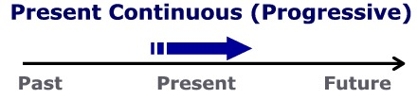
Present Continuous

Slide 3
Uses
1) actions happening at the moment of speaking (now, at the moment)
Time expressions for Present Continuous:
Now
Right now
In this moment

Slide 4
Form:
am
is
are
Subject
verb + -ing

Slide 5
THE PRESENT CONTINUOUS TENSE
AFFIRMATIVE: Play
I | am ‘m | playing
You We They | are ‘re
He She It | is ‘s

Slide 6
THE PRESENT CONTINUOUS TENSE
play
Right now he is playing football.

Slide 7
Form:
am
is
are
Subject
not
verb + -ing

Slide 8
THE PRESENT CONTINUOUS TENSE
Right now he is not playing soccer.
He is running.

Slide 9
THE PRESENT CONTINUOUS TENSE
INTERROGATIVE: Play
Am | I | playing?
Are | you we they
Is | he she it
Yes / No | I | am ‘m not | playing
 | You We They | are aren’t
 | He She It | is isn’t

Slide 10
Questions:
Am I playing soccer?
Are you playing soccer?

Slide 11
THE PRESENT CONTINUOUS TENSE
INTERROGATIVE: Play
What Where Why | Am | I | playing?
 | Are | you we they
 | is | he she it
I am …
You are…
He/she/it is…
We are…
They are…

Slide 12
WHAT IS SHE DOING?
draw
She is drawing a picture

Slide 13
4-2 SPELLING OF -ING
END OF VERB -ING FORM
*
Rule
1
A CONSONANT + -e
DROP THE -e and ADD -ing
smil
ing
e
example:
*
b,c,d,f,g,h,j,k,l,m,n,p,q,r,s,t,v,w,x,y,z

Slide 14
4-2 SPELLING OF -ING
END OF VERB -ING FORM
Rule
1
A CONSONANT + -e
DROP THE -e and ADD -ing
din
ing
e
example:

Slide 15
4-2 SPELLING OF -ING
END OF VERB -ING FORM
*
Rule
2
ONE VOWEL + ONE CONSONANT
DOUBLE THE CONSONANT and ADD -ing
sit
t
ing
example:
exception: do not double w, x, and y
a,e,i,o,u
*
pay
ying
?
ing

Slide 16
4-2 SPELLING OF -ING
END OF VERB -ING FORM
Rule
2
ONE VOWEL + ONE CONSONANT
DOUBLE THE CONSONANT and ADD -ing
plan
n
ing
ing
example:

Slide 17
4-2 SPELLING OF -ING
END OF VERB -ING FORM
Rule
3
TWO VOWELS + ONE CONSONANT
ADD -ing;
DO NOT DOUBLE THE CONSONANT
read
ing
example:

Slide 18
4-2 SPELLING OF -ING
END OF VERB -ING FORM
Rule
3
TWO VOWELS + ONE CONSONANT
ADD -ing;
DO NOT DOUBLE THE CONSONANT
sleep
ing
example:

Slide 19
4-2 SPELLING OF -ING
END OF VERB -ING FORM
Rule
4
TWO CONSONANTS
ADD -ing;
DON’T DOUBLE THE CONSONANT
brush
ing
example:

Slide 20
4-2 SPELLING OF -ING
END OF VERB -ING FORM
Rule
4
TWO CONSONANTS
ADD -ing;
DON’T DOUBLE THE CONSONANT
drink
ing
example:

Slide 21
ACTIONS THAT ARE HAPPENING AT PRESENT (1)
They are dancing right now.

Slide 22
A man is riding a bike

Slide 23
The dog is walking.

Slide 24
Shruti ___________ the piano.
is playing

Slide 25
The horse is running.
The kangaroo is jumping.

Slide 26

4-1 Let’s Practice
read
What is the girl doing?
is reading
She _________.

Slide 27
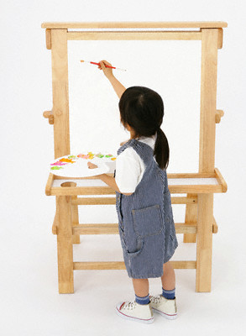
4-1 Let’s Practice
paint
What is the girl doing?
is painting
She _________.

Slide 28
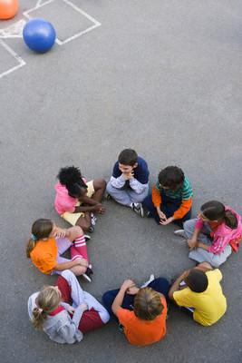
4-1 Let’s Practice
play
What are the children doing?
They _________.
are playing

Slide 29
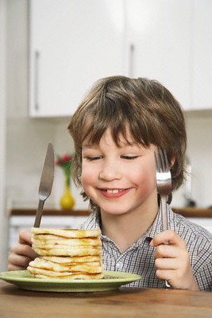
4-1 Let’s Practice
eat
What is the boy doing?
He _______.
is eating

Slide 30
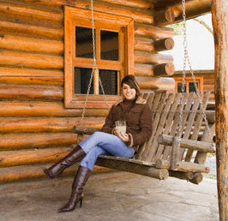
4-2 SPELLING OF -ING
She is sitting.

